Slide 1

CLIMATE CHANGE BELIEF ANALYSIS
Classification Predict

Slide 2
TEAM MEMBERS
Classification_JS1_DSFT21
Reneilwe Mphahlele
Tshegofatso Letlape
Kabelo Mbewe
John Bosman
Mathew van Wyk
Khwatsi Hlungwani

Slide 3

INTRODUCTION
INTERESTING FACTS
By 2050 over a million species will be extinct.
Increases in temperature will lead to plants having fewer days to grow and potentially less crops for us to consume.

Slide 4
INTRODUCTION
Many companies are built around lessening one’s environmental impact or carbon footprint
The main aim for this project is to determine how people perceive climate change and whether or not they believe it is a real threat.
Providing an accurate and robust solution to this task gives companies access to a broad base of consumer sentiment, spanning multiple demographic and geographic categories - thus increasing their insights and informing future marketing strategies.

Slide 5
Problem statement
Build an effective Machine Learning model that is able to classify whether or not a person believes in climate change, based on their novel tweet data.

Slide 6
Data science process
Phase 1
DATA COLLECTION
Phase 2
DATA CLEANING
Phase3
Phase 4
Phase 5
MODEL BUILDING
MODEL DEPLOYMENT
EXPLORAROTARY DATA ANALYSIS

Slide 7
Import libraries and dataset
Import all the necessary libraries
Read the datasets that are given

Slide 8
DATA PRE-PROCESSING
Checking info of all data
Checking summary statistics of all data
Checking for missing data
Checking for unique classes in our sentiment
Checking whether a character is white-space character or not

Slide 9
Data CLEANING
Testing the Porter Stemmer
Testing Lemmatization
Use nlp tool to transform messages into more digestible form
Remove RT, URL and trailing white spaces
Remove stop words and punctuation
Combining all the messages

Slide 10
Exploratory data analysis
Labeling the target
checking the numerical distribution
Visualizing text lengths for each sentiment
Extracting Users in a column
Generating Counts of users

Slide 11
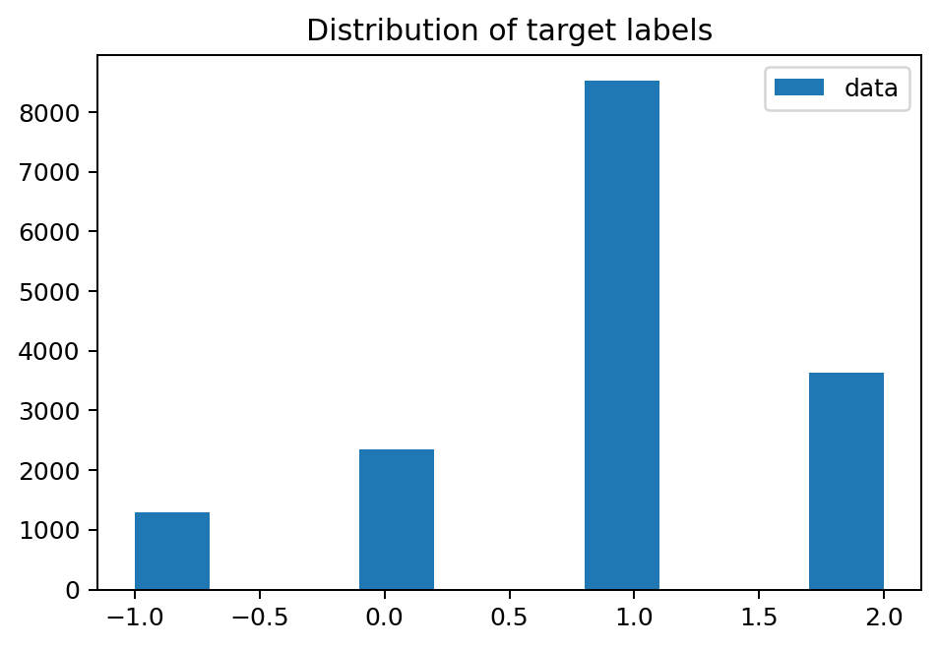
Distribution plot

Slide 12
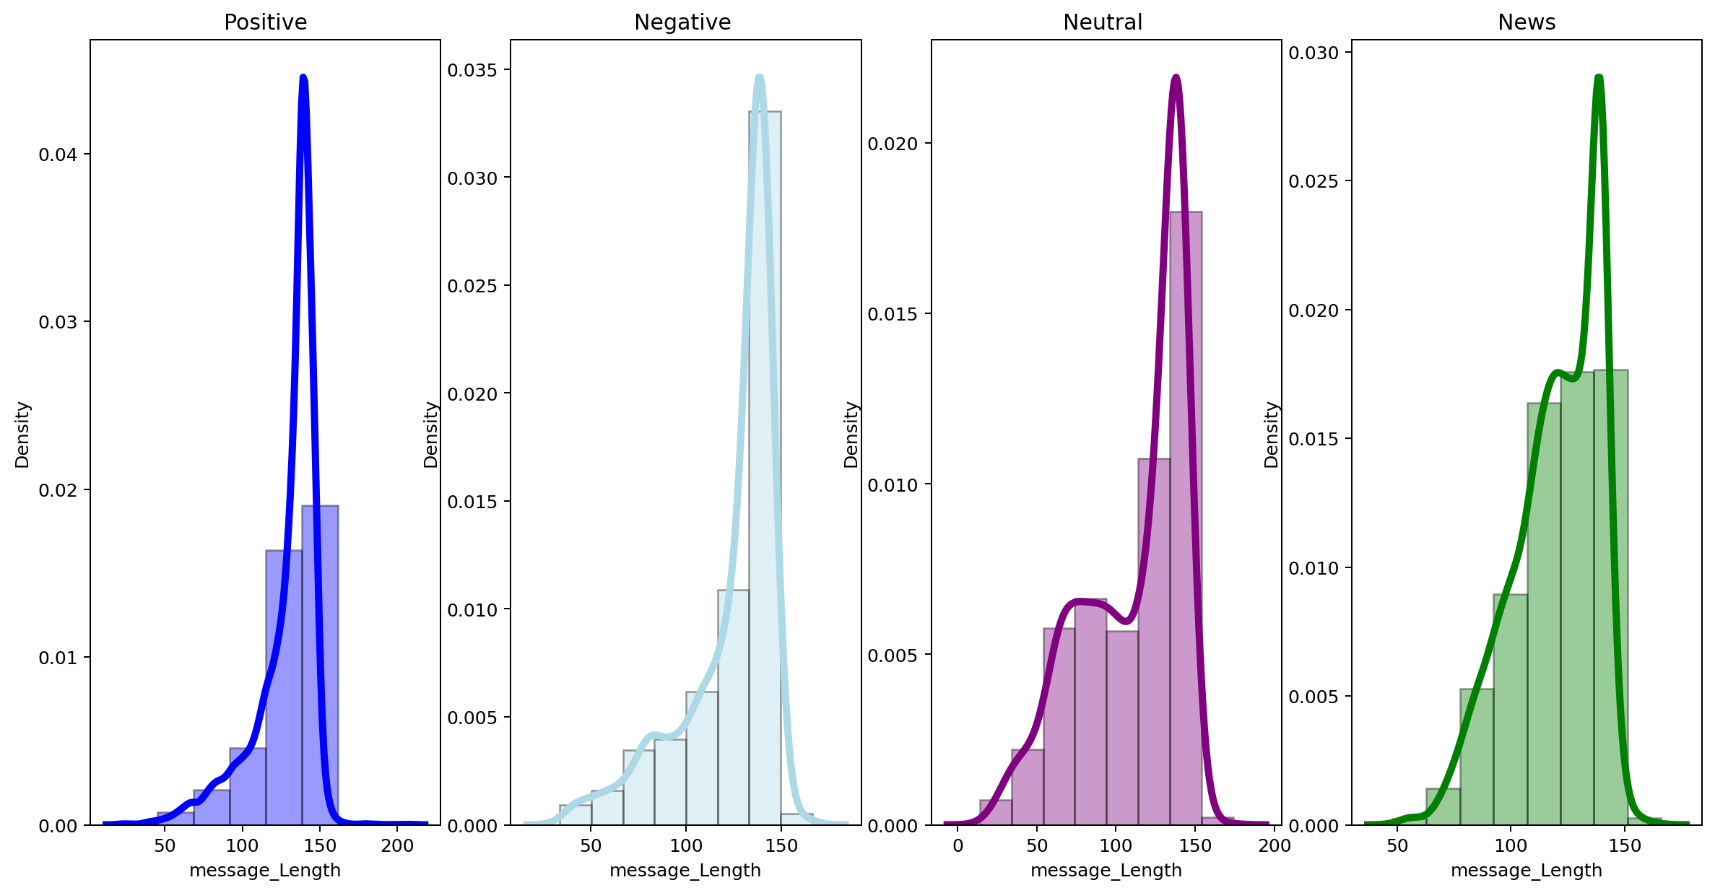
Density plot

Slide 13
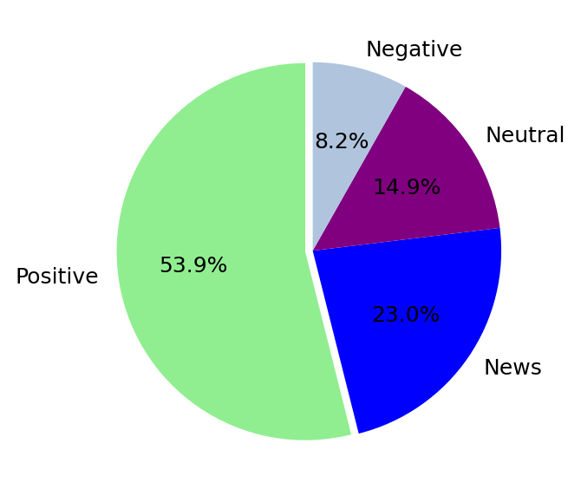
Numerical distribution

Slide 14
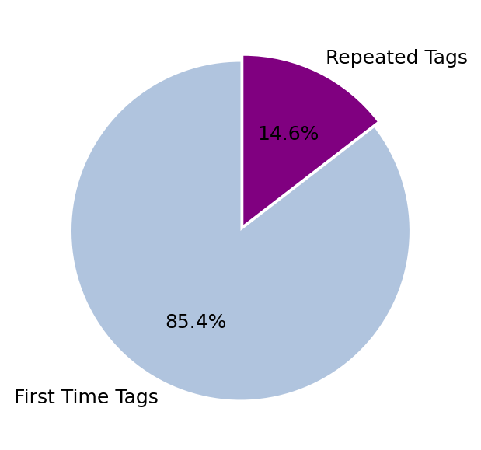
Numerical distribution

Slide 15
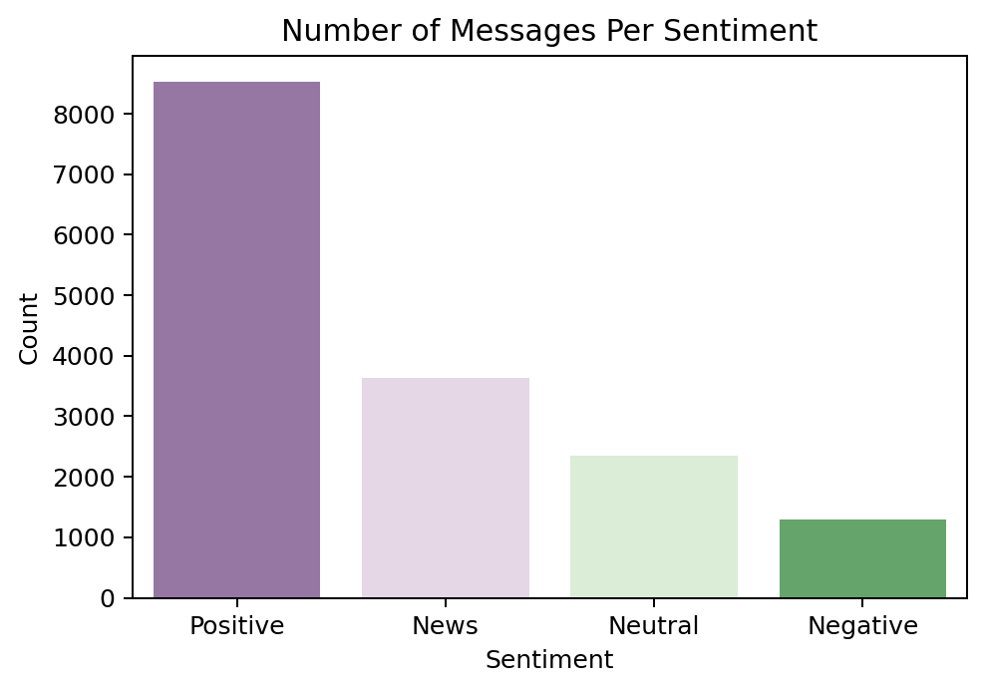
sentiments

Slide 16
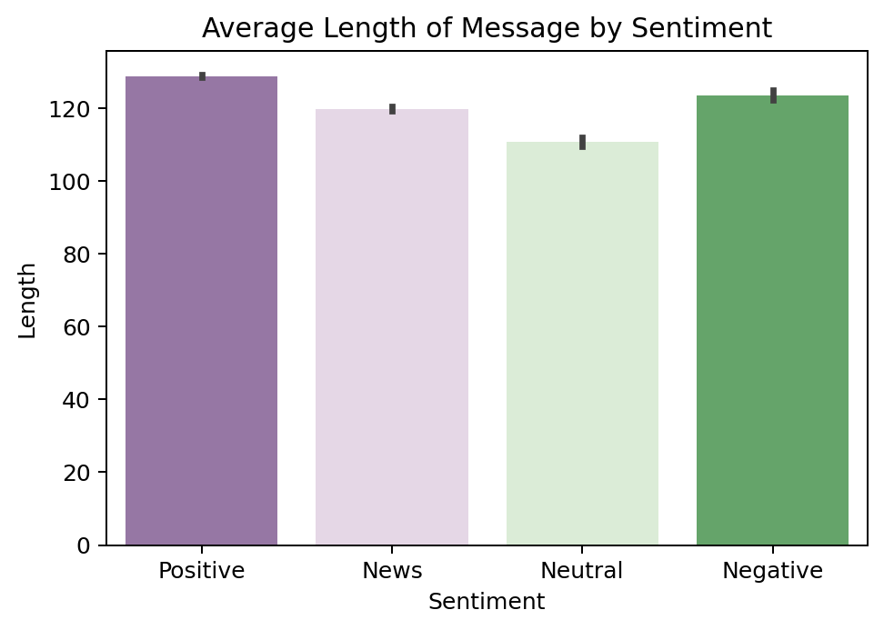
sentiments

Slide 17
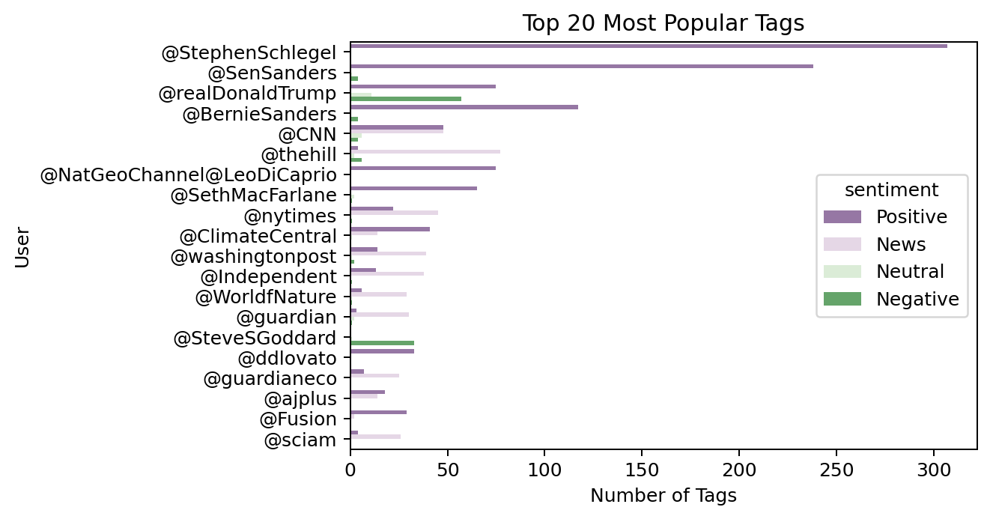
Popular tags

Slide 18
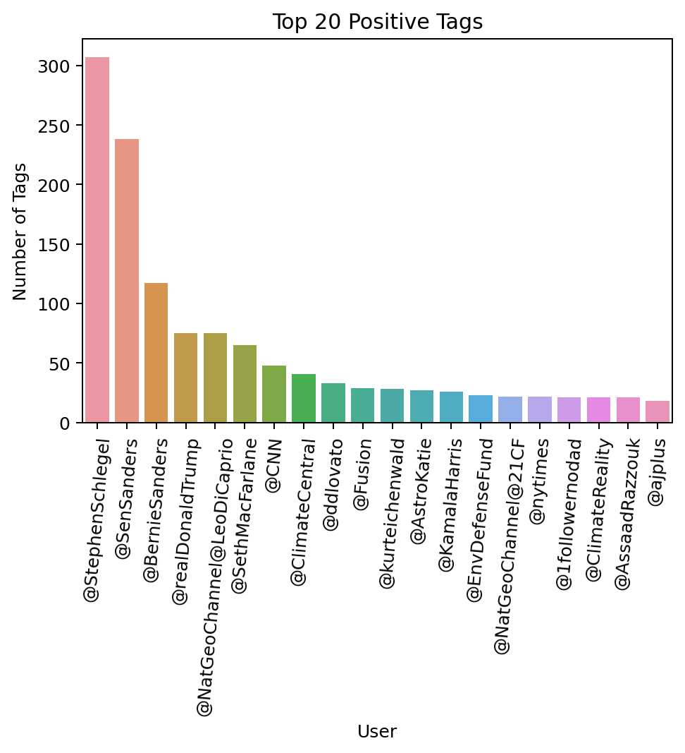
Positive tags

Slide 19
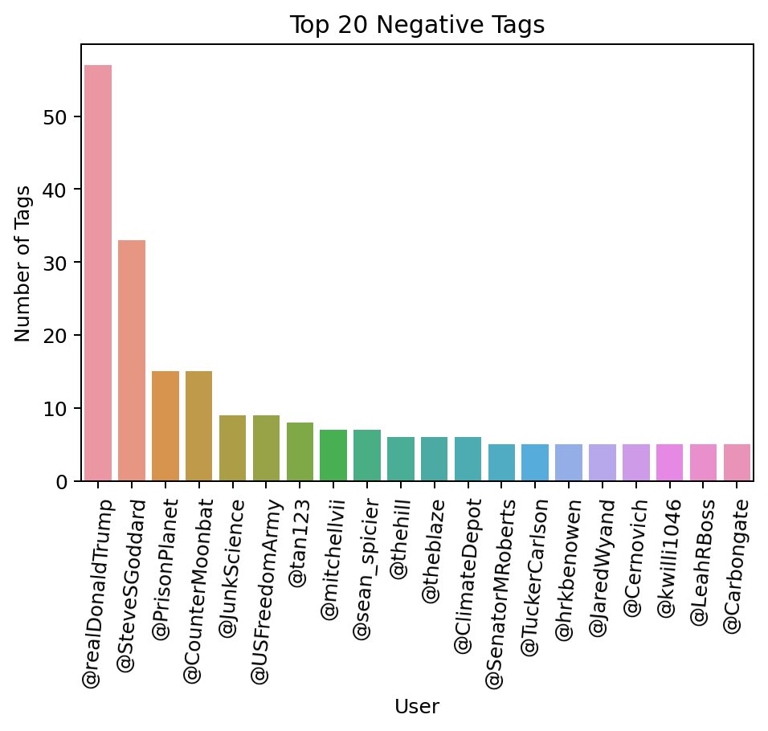
Negative tags

Slide 20
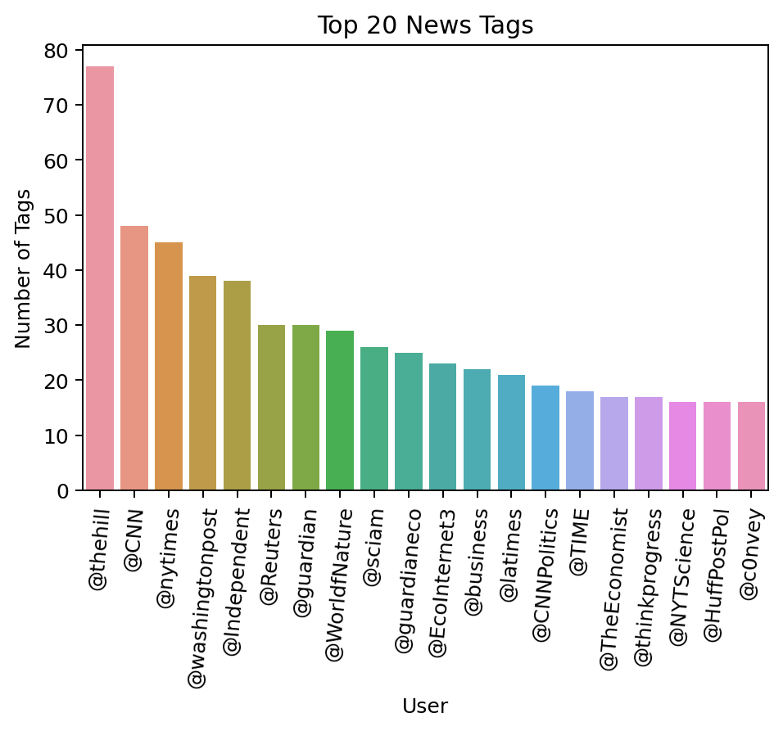
News tags

Slide 21
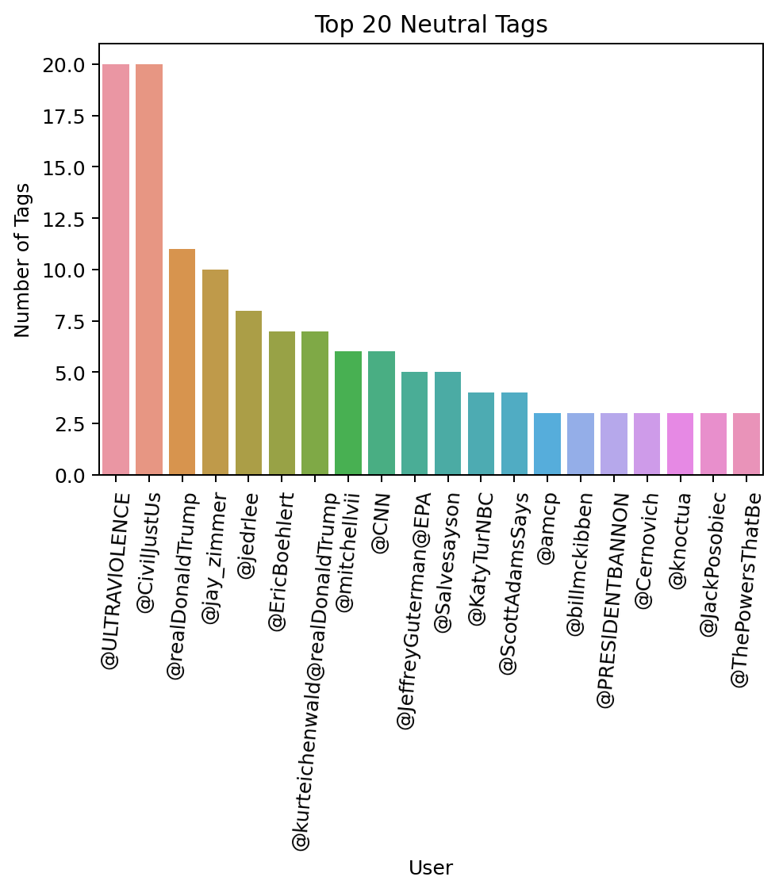
Neutral tags

Slide 22
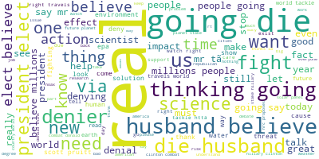
POSITIVE WORD CLOUD

Slide 23
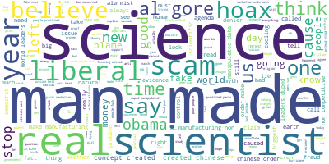
NEGATIVE WORD CLOUD

Slide 24
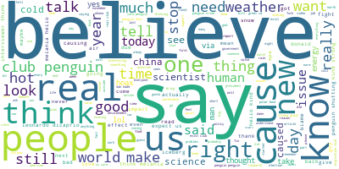
NEUTRAL WORD CLOUD

Slide 25
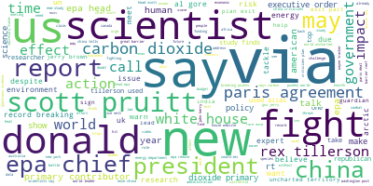
NEWS CLOUD

Slide 26
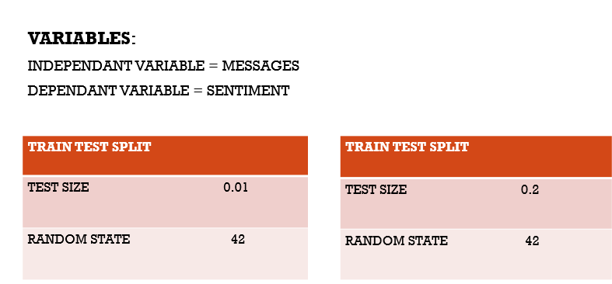
FEATURE ENGINEERING

Slide 27
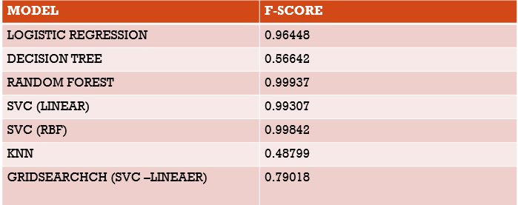
MODEL

Slide 28
CONCLUSION
FROM OUR MODEL BUILDING AND EVALULATION OF CLIMATE CHANGE TWEETS, SVC (LINEAR) MODEL PROVIDED US WITH A BEST SCORE OF 0.75616.

Slide 29

QUESTIONS

